Slide 1

Data 490 Final Presentation
Philip Bailey

Slide 2

Problem Statement
Can Unemployment and Labor Force Participation predict future crimes on a statewide scale?

Slide 3

Data Sets
 | Maryland | New York | Washington
Unemployment | 1976 - 2022 | 1976 - 2022 | 1976 - 2022
Labor Force Participation | 1976 - 2022 | 1976 - 2022 | 1976 - 2022
Crime Statistics | 1975 - 2020 | 1990 - 2022 | 2000 - 2022

Slide 4

Data Structures
Unemployment Data Sets
Labor Force Data Sets
Date | Unemployment
1976-01-01 | 8.7833333333333333
Numeric | Numeric
Date | Labor Force
1976-01-01 | 61.3916666666666667
Numeric | Numeric
Washington Crime Data Set
Year | County | Pop_Total | SRS_TOTAL | NIB Total | -
1990 | STATE | 4866692 | 300546 | * | -
Numeric | Character | Numeric | Numeric | Numeric | -
*Washington Police switched crime reporting systems in 2011 from SRS to NIB
-This data set has over 50 Columns. Taking this into account I only included relevant columns

Slide 5

Data structures cont.
Maryland Crime Data Set
Jurisdiction | Year | Population | Grand.Total | -
Allegany County | 1975 | 79655 | 300546 | -
Character | Numeric | Numeric | Numeric | -
-This data set has over 30 Columns. Taking this into account I only included relevant columns
New York Crime Data Set
County | Year | Population | Yearly_Crime | -
Albany | 1990 | 292594 | 1137689 | -
Character | Numeric | Numeric | Numeric | -
-Only relevant columns were included

Slide 6




Data Joins​ Example
Maryland State Data
New York State Data
Washington State Data
Year (PK) | Numeric
Total Crime | Numeric
Unemployment | Numeric
Labor Force | Numeric
State | Character
Year (PK) | Numeric
Total Crime | Numeric
Unemployment | Numeric
Labor Force | Numeric
State | Character
Year (PK) | Numeric
Total Crime | Numeric
Unemployment | Numeric
Labor Force | Numeric
State | Character
Year (PK) | Numeric
Total Crime | Numeric
Unemployment | Numeric
Labor Force | Numeric
State | Character
Year (PK) | Numeric
Total Crime | Numeric
Unemployment | Numeric
Labor Force | Numeric
State | Numeric
Combined State Data
Year (PK) | Numeric
Total Crime | Numeric
Unemployment | Numeric
Labor Force | Numeric
State | Character

Slide 7



Data Joins​ Example
Maryland State Data
Maryland Crime Clean (Source)
Columns containing the date were all renamed Year
Total Crime columns for all three states needed to be renamed
All states data were combined into their own subset
State Column added to each state data set to identify them when combined
Maryland State Data
Year (PK) | Numeric
Total Crime | Numeric
Year (PK) | Numeric
Total Crime | Numeric
Unemployment | Numeric
Labor Force | Numeric
State | Character
Maryland Unemployment (Source)
Year (PK) | Numeric
Unemployment | Numeric
Maryland Labor Force (Source)
Year (PK) | Numeric
Labor Force | Numeric

Slide 8

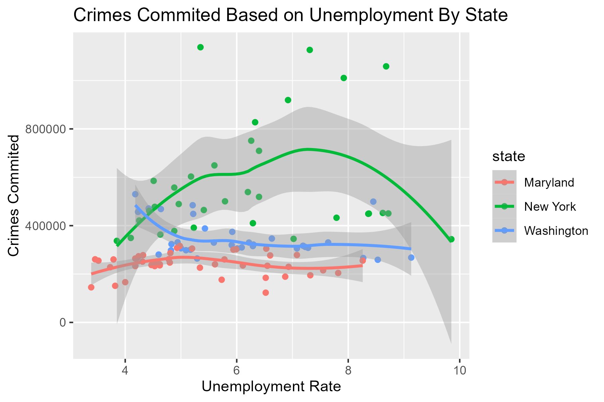
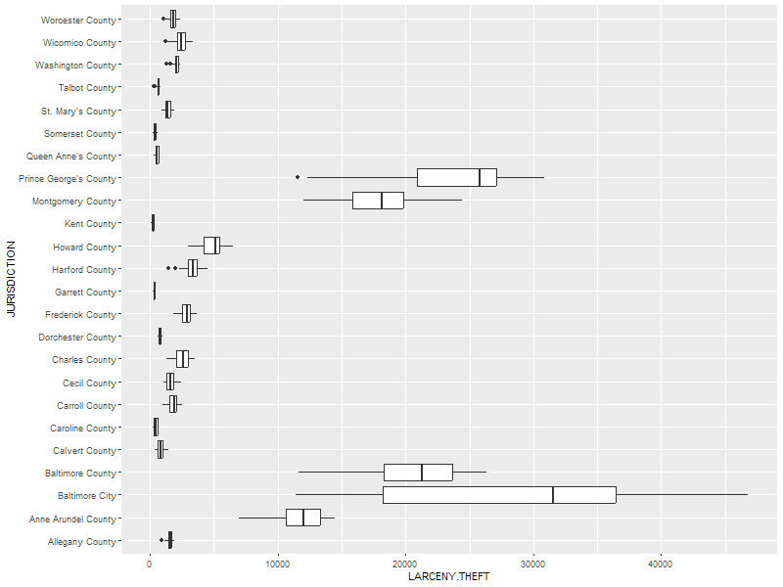
Data Exploration
Unemployment vs Crime State by State
Multivariate
Boxplot of Larceny Theft of Maryland Counties
Bivariate

Slide 9
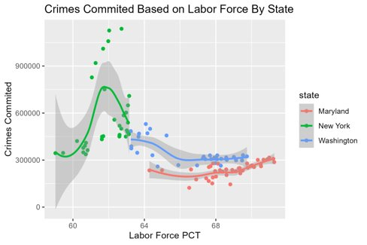
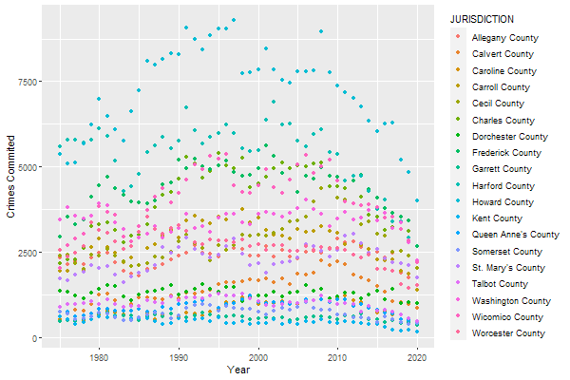
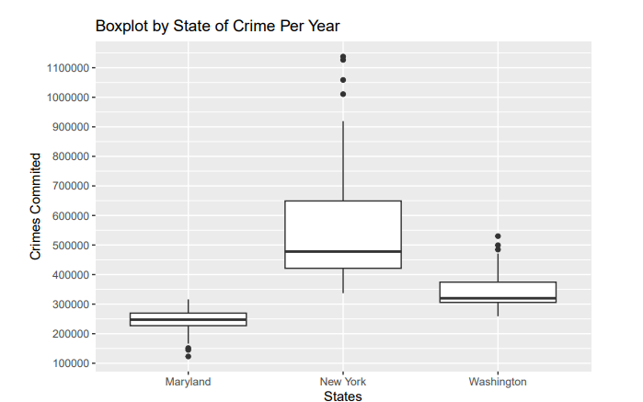
Data Exploration Cont.
Scatterplot of Labor Force vs Crime State by Sate
Multivariate
Scatterplot Larceny Crime Maryland W/ Pop Cap
Multivariate
Boxplot of Crime Distribution by State
Univariate

Slide 10
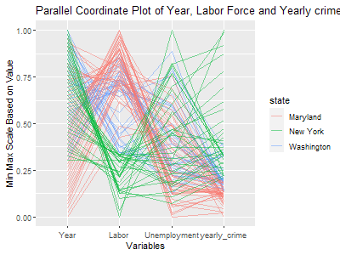
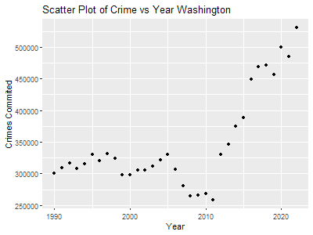
Data Exploration
Plot of Year, Labor, Unemployment and Yearly Crime
Multivariate
Scatterplot of Crime vs Year in Washington
Bivariate

Slide 11

Models Used
PCA
Negative Binomial

Slide 12

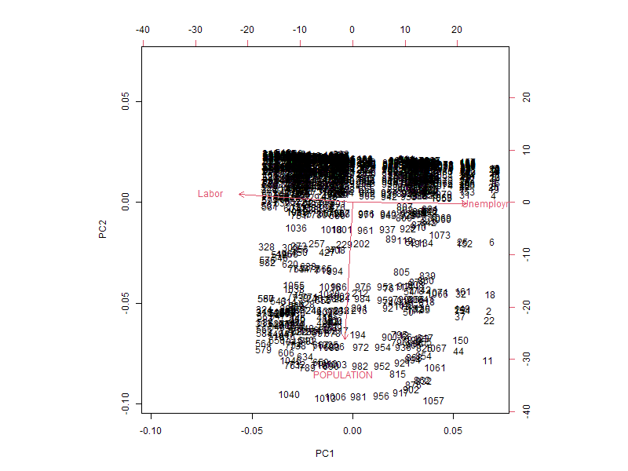
Model 1:PCA
In this machine learning model, I tested to see if certain crimes could be predicted better than others. I used unemployment, labor force percentage and population as my independent variables. To the right is a biplot of the PCA with my independent variables

Slide 13
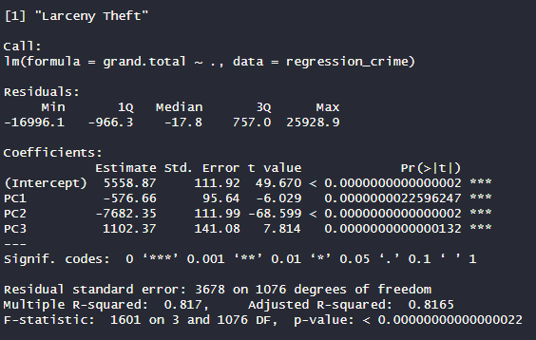
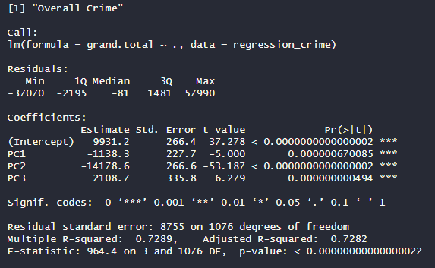
Model 1:PCA
My dependents were MURDER, ROBBERY, AGG..ASSAULT, B...E, LARCENY.THEFT, M.V.THEFT, GRAND.TOTAL, VIOLENT.CRIME.TOTAL. My control was overall crime. I then fit a linear model to each type of crime and compared the r scores. This is a measure for variability explained by a model. The higher the score the better the model can have an accurate prediction. In the end the only dependent to have a higher r score than the control was Larceny theft.

Slide 14
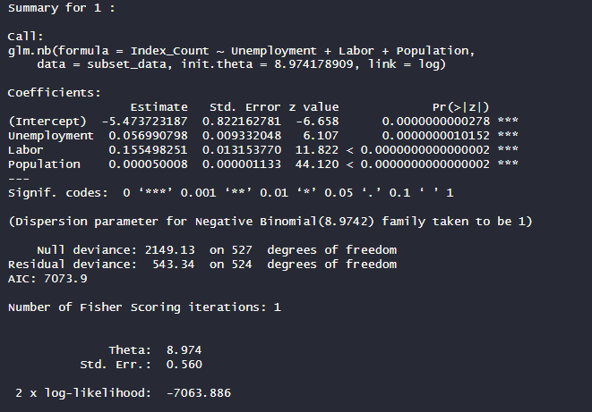
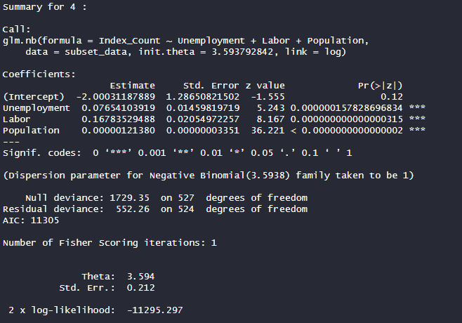




Model 2: Negative Binomial
For my second model I investigated if population would have an effect on a model's ability to predict crime. In this model I used data from New York State and broke it into four population groups. I settled on a Negative Binomial Regression because of the high variability in the data. When I attempted a Poisson Regression the deviance and AIC were way too high to draw accurate conclusions. In the end I discovered that as population increases it decreases the accuracy of a model to predict crime. I measured this with the AIC which is a measure of goodness of fit for the model.

Slide 15
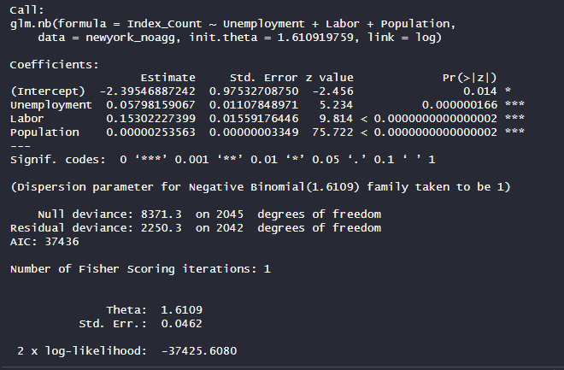
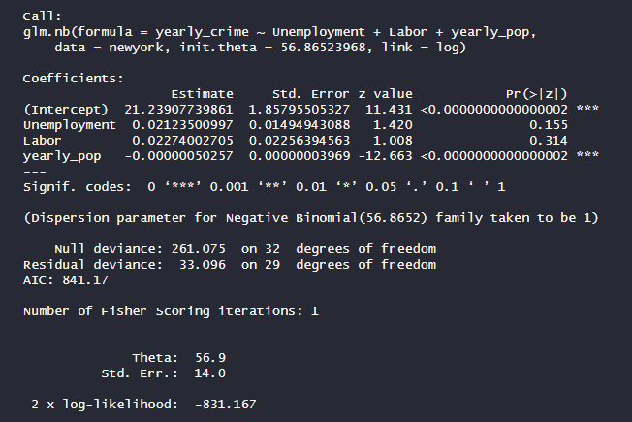




Model 3: Negative Binomial
In my third model I went with another Negative Binomial Regression to explore if aggregating crime data would influence a model's ability to predict crime. For this model I used the data from New York State. I found that aggregated crime data was more accurate because its AIC was lower, and its deviance was close to the degrees of freedom.

Slide 16
Project Conclusion
After all the data exploration, model development and hypothesis testing I came to a couple conclusions. First, I do believe that you can predict crime with Unemployment and Labor Force Prediction. While they cannot predict crime with precision, I do believe they explain a significant portion and rather paint with a wide brush the general trends of crime. Second, I believe that these economic factors can be used to predict certain crimes better than others. This becomes evident when looking back at my first model where Larceny theft has the highest accuracy and murder with the lowest. Explaining why someone stole is a lot more predictable than explaining why someone commits murder. There are clear economic factors that would lead someone to steal like if they lost their job or can't find one. Third and last, the population of county drastically effects the ability for Unemployment and Labor to project future crimes. This is makes sense when you think about how smaller counties have less people and thus are less impacted by economic conditions.

Slide 17

Thank You
someone@example.com

